Slide 1

Azure Service Bus Engineering for performance and stability
Eldert Grootenboer
Senior Program Manager at Microsoft

Slide 2

Azure Service Bus Engineering for performance and throughput
Eldert Grootenboer

Slide 3

Speaker Bio
Eldert Grootenboer
He/Him
Program Manager - Azure Service Bus
@egrootenboer
egrootenboer@microsoft.com
Notes:
Explain that performance is one of the most common asks I get. For example, a large crypto currency broker, looking for high throughput (100MBs). Talk about TTL and MaxConcurrentCalls.

Slide 4

What to expect?
Quick introduction
Upcoming previews
Recently released
Optimizing for performance

Slide 5

Azure Service Bus

Slide 6
What is Azure Service Bus?
Platform-as-a-Service Queue and PubSub message broker
Fully managed
AMQP 1.0 and JMS 2.0 compliant
Polyglot Azure SDK
Industry-leading reliability and availability
Integration with other Azure services
Notes:
Platform-as-a-Service Queue and PubSub message broker
Fully managed: You use the features, Azure deals with everything else
JMS 2.0 and AMQP 1.0 standards compliant
Polyglot Azure SDK and cross-platform client support
Industry-leading reliability and availability
Integration with other Azure services
Simple to use from Functions and Logic Apps
Idiomatic language support
.NET
Java
JMS 1.0 and 2.0
Azure SDK for Java
Python
Typescript
Go
Integration with other Azure services
Event Grid
Logic Apps
Azure Functions
Power Platform
Dynamics 365
Stream Analytics

Slide 7










Azure Messaging Platform
AMQP
JMS
Connect apps on an enterprise message queueing and pub-sub platform using open protocols including JMS 2.0​
Message Queue Broker
Azure Service Bus
Elastic Pub-Sub Broker​
Publish and subscribe MQTT messages and HTTP push and pull for delivery of discrete events​
>75% of S500 customers use 2 or more of our messaging services
Azure Event Grid
Event Stream Engine​
Cloud-scale, low latency streaming platform supporting Apache Kafka and AMQP clients and services​
Azure Event Hubs
Event Stream Processor
Real-time stream processing and analytics engine with rich development tools and low/no-code editor experiences​
Azure Stream Analytics
Notes:
We just discussed what Service Bus does do, but what doesn’t it do and in which scenarios should you use different services?

Slide 8

Upcoming previews

Slide 9

Durable terminus
We see more connection issues with containers and distributed systems
Allow recovery of broken links
Keeps track of full message state
Notes:
When looking for performance, we see customers often leveraging containers, f.e. with KEDA. But what to do if a container loses it’s connection?
Interoperability
Terminus - Encapsulates the endpoint state associated with an AMQP Terminus. An AMQP Terminus acts as either a source or target for messages, but never both. Every AMQP link is associated with both a source terminus and a target terminus that is negotiated during link establishment. A terminus consists of an AMQP address, along with several other properties defining the quality of service and behavior of the link.
Link – Provides a unidirectional transport between two nodes. A link attaches to a node at a terminus.
Terminus recovery
Allow for recovery of terminus with link name, allowing clients to reconnect to the service without creating a new sender or receiver. The SDK will track the unsettled map on the client and when it reconnects it will send this to the service for consolidation.
Durable locks
After connection loss, whether this is due to network connectivity or node restarts, keep the message state information of the terminus available on reconnection of the link.
Configuration of durability policy
Allow each client to configure their durability policy. If a durability policy of None is chosen, durable terminus will be disabled.
Maximum of 5000 active terminuses per namespace
As a terminus is expected to be restored relatively quickly after a connection breaks, we will keep this in line with the maximum number of connections on a namespace.
Terminus management
It should be possible to retrieve a list of active terminuses through the API, as well as deleting an existing terminus, closing any existing links. This will allow customers to manage orphaned terminuses. Also allow retrieving details of a specific terminus, such as it's AMQP address and other properties defining the quality of service and behavior of the link.
Connect to existing terminus
Allow to connect to an existing terminus, by letting the client provide the link state, thus letting one client pass work to another.
Configuration of timeout
Allow client to specify the timeout value when using durable terminus. Minimum value will be 30 seconds, while the maximum will be 2 hours.
Configuration of expiry policy
Client should be allowed to set the expiry policy for their durable terminus. If policy Never is chosen, an exception will be thrown, as we do not support this.
Terminus management in Service Bus Explorer
Show an overview of the existing terminuses in the Service Bus Explorer and allow to delete an existing terminus. Allow retrieving the details of a specific terminus and displaying its properties.
Message consolidation when client does not have recollection of unsettled map
When using intermediate brokers, the client might not have access to the unsettled map when reconnecting.

Slide 10

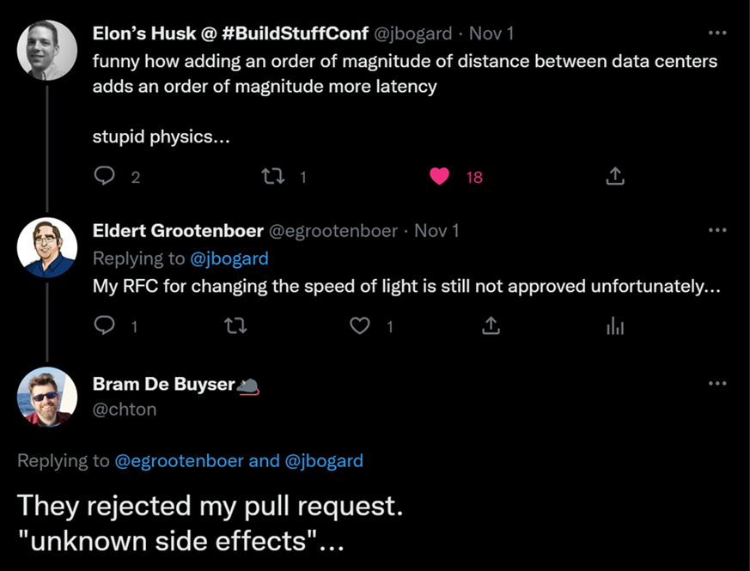
Geo data replication
Full data replication across multiple regions
Synchronous and asynchronous replication
Manual failover with telemetry
Releasing for Event Hubs and Service Bus
Notes:
When you need high performance on SB, this is often a mission critical system. How do we make sure that we can quickly continue in case of disaster?
Implement data replication across regions for data and metadata
Expand the current capabilities of the GeoDR feature to also include metadata.
Use any region
Customer can configure failover to any region they want.
Multiple failover regions
Allow customers to set multiple failover regions, providing them with the option to remain highly available even after failover. Data will be replicated between all regions.
Customer can failover to any healthy region
Customers can initiate failover at any time to a healthy region. This will also allow them to fail back to a previous primary region, once this region is healthy again.
Provide choice between strong and eventual consistency
Customer can decide between strong and eventual consistency.
Strong consistency requires at least 3 replicas
We use quorum-based commits with strong consistency, meaning that a majority of replicas need to acknowledge an operation before acknowledging the result to the client. A majority is calculated as (number of replicas / 2) + 1. This will result in a RPO 0 scenario.
Configure maximum RPO for eventual consistency
When using eventual consistency, the customer can configure the maximum RPO.
Provide telemetry around healthiness of secondary replicas
Implement telemetry indicating if the secondary replicas are healthy or have issues. This way the user can set up an alert and decide on follow-up actions.
Lagging replicas are caught up when becoming healthy again
If a secondary replica is lagging on the primary replica, this will be reported to the user through telemetry. If the user decides to wait, and the secondary replica becomes healthy again, it will be caught up to the current state of the primary replica.
Seamless failover
Failover should be seamless for clients. This is done by having a single FQDN clients connect to, which will automatically point to whichever is the primary replica at that point.
Manual failover
We allow customers to initiate a manual failover. This will give them full control over when they want to failover, allowing them to coordinate this with failover of other components. Moreover, this will provide the possibility to do disaster recovery testing.
Support for active / passive setup
The secondary replicas are passive only, customers will not be able to read or write in these regions.
Provide siphoning options on failover
When initiating failover, the customer can indicate the way they want to siphon messages from the primary to the secondary region. Options will include siphoning during failover (synchronous, with maximum grace period), after failover (asynchronous), or skip siphoning.
RTO of 1 minute
We will aim to keep the RTO as low as possible, with a maximum of one minute. This means that from the moment a failover is triggered, the customer can experience at most one minute of their namespace not being available. If the customer choses to do synchronous siphoning, the RTO is one minute plus the configured grace period.
Replicate entire configuration
We replicate the complete configuration of a namespace including, but not limited to, network configuration, authentication, scaling, RBAC, encryption configuration, etc.
Metrics are emitted on replica level
All metrics should be shown on a replica level instead of a namespace level. This allows the user to identify the performance and healthiness of each replica.
Emit Event Grid events on health changes and failover
When the health state of a region changes, an event will be sent out to Event Grid. This allows customers to initiate actions on this. Additionally, send out an event when a failover has been initiated. This could especially be interesting when combined with automatic failover, as it could trigger failover of other components.
Enable GeoDR on existing namespaces
Initially GeoDR will be enabled on new namespaces only. However, before going into GA, we need to allow customers to enable this on their existing namespaces. Customers using this type of feature usually can’t move their clients over easily to a new namespace.
Support for active / active-passive setup
Both the primary and secondary regions can be used for reads. Only the primary region can be used for writing. Configuration will be pushed from the primary region.
Support for active / active setup
Both the primary and secondary regions can be used for reading and writing. Written data will be synchronized between all regions. Configuration will be pushed from the primary region.
For example, the telemetry that is used internally to decide if we need to switch to another availability zone.
@Eldert - Good to define RPO, RTO etc.
Done.

Slide 11

Recently released

Slide 12

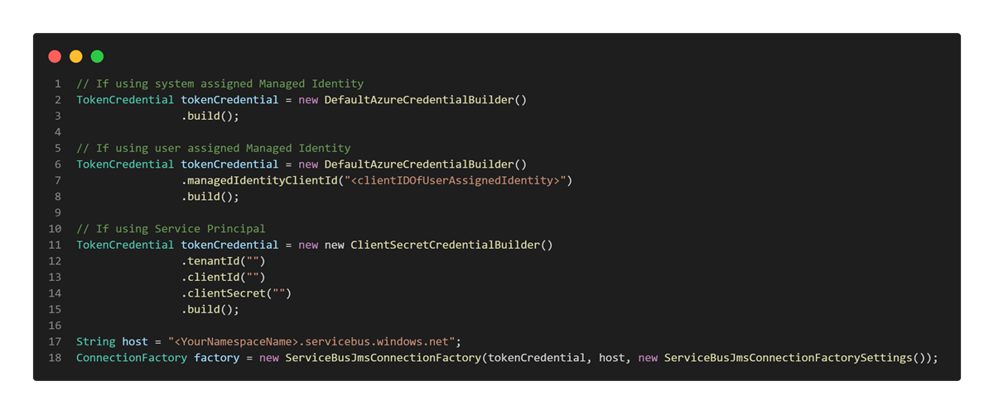
Passwordless authentication for JMS
AAD backed authentication
Support for managed identities and service principals
Notes:
Many of our high-performance customers come from brokers such as IBM MQ and Tibco EMS. And are now moving to SB. By providing them with JMS compatibility, we give them the option to easily migrate. And by providing passwordless auth, they can easily integrate this in their Azure landscape.

Slide 13

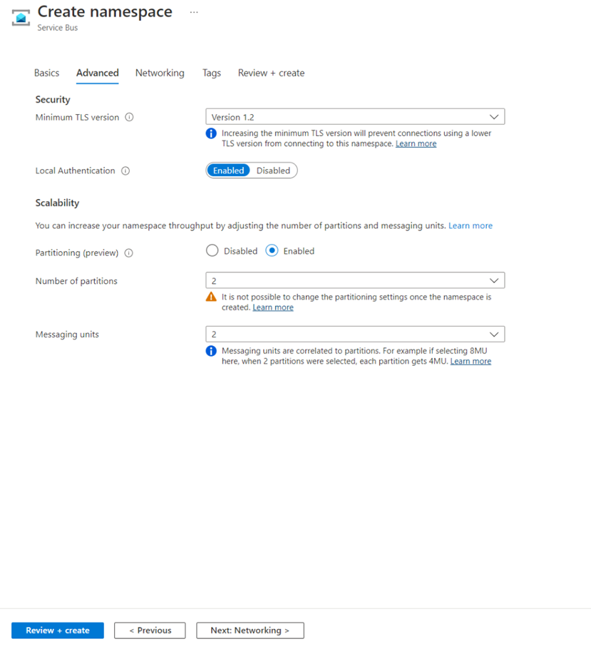
Performance features
Consistent low latency on your entities
Multi-tiered storage
Vastly improves reliability
Partitioned namespaces for premium
Higher scalability by allowing multiple partitions in Premium namespaces
High throughput scenarios, where absolute order and message distribution are less important
Relative order is still preserved
Order can be enforced using partition keys or sessions
Notes:
And of course, we also want to provide options to our customers that have the largest throughput requirements. Talk about automotive customers, that has 15000 different microservices, that are all backed by SB for pub sub.

Slide 14

Performance optimization
Notes:
Talk about how we are helping a large pharmacy store, to validate their architecture and performance implementation, as they are expecting to have 10000 stores running all their prescriptions over SB.

Slide 15
SKU
Standard
Development / test scenarios
Low throughput scenarios
Shared resources
Throttling may occur
Premium
Production scenarios
Predictable latency and throughput
Partitioning
Auto-scaling for spikes
Notes:
Use this slide to gauge interest in a mid-tier and dedicated offering
We are looking at this from a performance standpoint. There are more reasons to go for Premium, but those are not discussed today.
Standard tier - Suited for developer/test environments or low throughput scenarios where the applications are not sensitive to throttling.
Premium tier - Suited for production environments with varied throughput requirements where predictable latency and throughput are required. Additionally, Service Bus premium namespaces can be auto scaled and can be enabled to accommodate spikes in throughput.
Throttling does not lead to loss of data. Applications leveraging the Service Bus SDK can utilize the default retry policy to ensure that the data is eventually accepted by Service Bus.
1000 credits on standard per namespace, migrate to premium once you hit this. Any API call can consume between 1-5 credits depending on the operation. Runtime operations in general consume less credits than management operations. Credits are also consumed
Cutover point to 1MU on Premium is at around 500 msg/sec sustained load.
Service Bus keeps some messages in cache, to improve receive throughput. It trims cache only when memory usage exceeds a certain high threshold like 90%. It is not something to worry about, as service bus will trigger the garbage collector to clear cache

Slide 16
Namespaces sharding
Partitioning
Allows namespaces to scale beyond 16MU
Use for heavy single workloads
Resources do not linearly scale
Sharding
Run workloads on multiple namespaces
Recommended if single workload !> 16MU
Can shard across regions

Slide 17

Feature usage
Sessions
Fan out to multiple subscriptions
Multiple / complex filters on subscriptions
Scheduled messages
Deferred messages
Transactions
De-duplication
Forward to

Slide 18

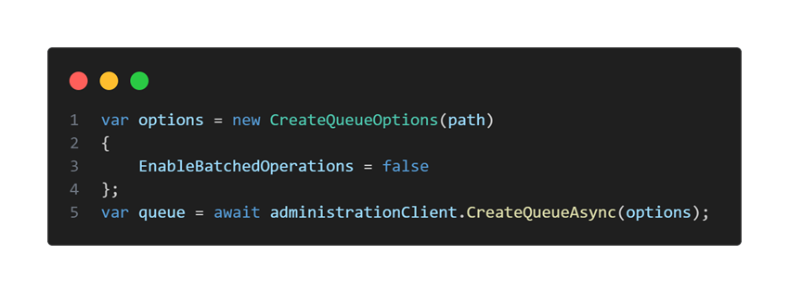
Considerations
Protocol
SDK
Receive mode
Quotas and limits
Batching store access

Slide 19

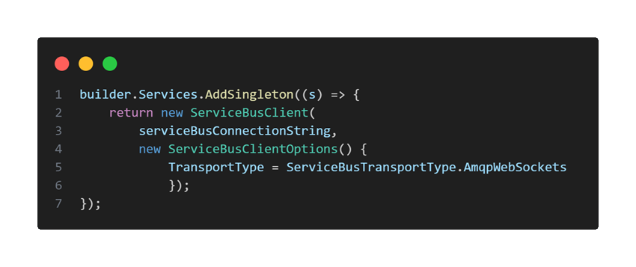
Reusing factories and clients
Create clients as singletons
Instantiate once and share
Don’t close or dispose the client
Notes:
This was one of the main issues that the large crypto broker ran into. Just by optimizing this, we raised their throughput about 50-fold.

Slide 20

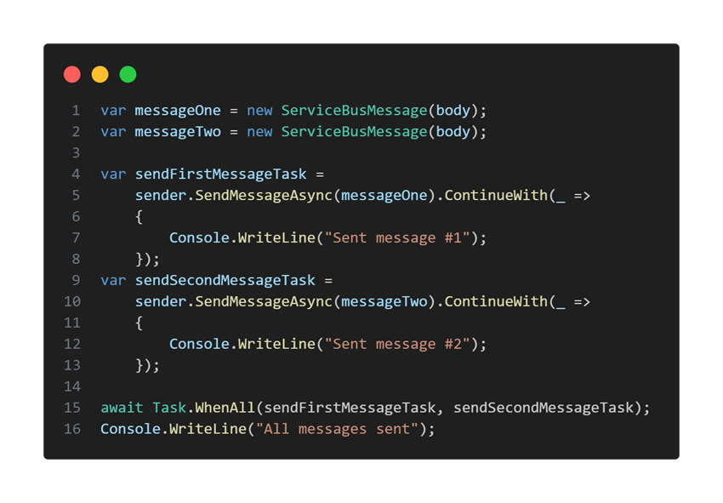
Concurrency
Operations take time
Use async tasks to work concurrently

Slide 21

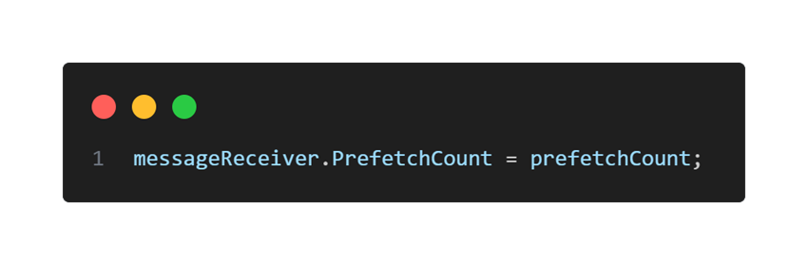
Prefetching
Reduces throughput by reducing roundtrips
Loads additional messages on receive
Prefetched messages are locked
Not recommended if high degree of reliability is needed, and processing takes significant work and time

Slide 22

Batching
Send and receive
Choose the right batch sizes

Slide 23

Calculating throughput
Benchmark tool for premium SKU
Use production-like workloads
Apply best-practices
https://aka.ms/SBPerformanceTest

Slide 24

Demo
Notes:
Give context on how customers use this tool

Slide 25
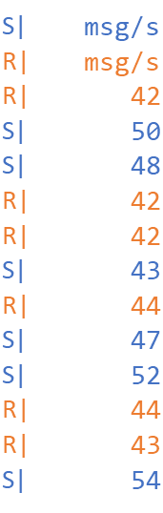
Demo 1 – Single client
$senders = 1
$receivers = 1
$inflightSends = 1
$inflightReceives = 1
$prefetchCount = 0
$sendBatchCount = 0

Slide 26
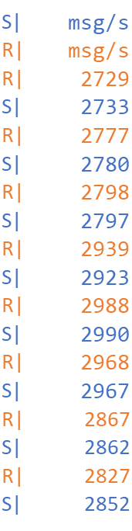
Demo 2 – Multiple clients
$senders = 50
$receivers = 100
$inflightSends = 1
$inflightReceives = 1
$prefetchCount = 0
$sendBatchCount = 0

Slide 27
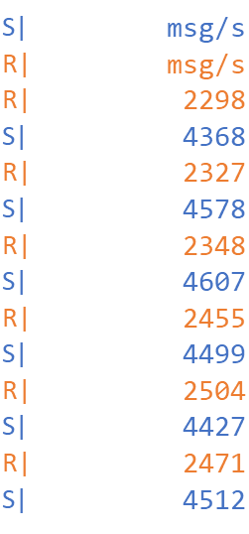
Demo 3 - Concurrency
$senders = 1
$receivers = 1
$inflightSends = 100
$inflightReceives = 100
$prefetchCount = 0
$sendBatchCount = 0

Slide 28
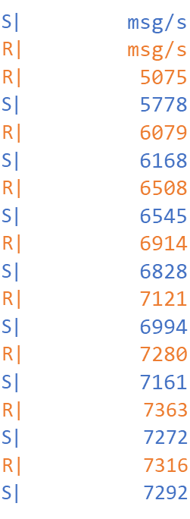
Demo 4 – Multiple concurrent clients
$senders = 50
$receivers = 100
$inflightSends = 100
$inflightReceives = 100
$prefetchCount = 0
$sendBatchCount = 0

Slide 29
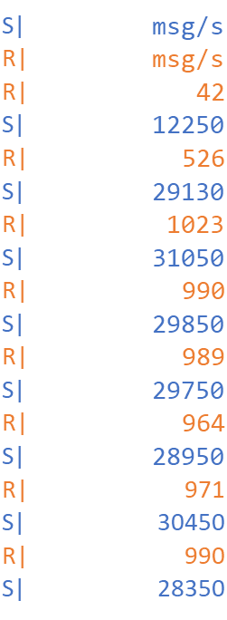
Demo 5 - Batching
$senders = 50
$receivers = 100
$inflightSends = 100
$inflightReceives = 100
$prefetchCount = 100
$sendBatchCount = 200

Slide 30

Almost done…

Slide 31
Takeaways
Performance is key
Design and implement with performance in mind
Provide your feedback

Slide 32





Thank you!
@egrootenboer
servicebuspm@microsoft.com
https://www.linkedin.com/in/eldert-grootenboer
https://aka.ms/AzureServiceBus-Feedback
https://aka.ms/SBPerformance

